Slide 1
Data Analyst Nanodegree
Session 5
Conducted by: Hamza
Notes:
https://udacity.zoom.us/j/7991233356
<number>

Slide 2
Agenda
Hypothesis testing
P-values
Confidence interval
Classical tests
Central limit theorem
bootstrapping
Mobile game project

Slide 3

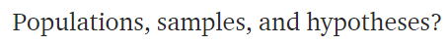
Statistics
Notes:
Most important question in statistics?
<number>

Slide 4

Default action

Slide 5


Notes:
Search for aliens on a planet ur manager is waiting for a report that has only this.
Yes or no
<number>

Slide 6

Notes:
Oxygen almost finised
U won’t be able to discover the whole planet
Uncertainty
What if I didn’t find info, shall I answer with yes or no?
<number>

Slide 7
Default action
Notes:
U can choose any.
In fact it is an MBA question that has to deal with decision maker not with numbers
It is a decision taken while relaxing on a coach
<number>

Slide 8

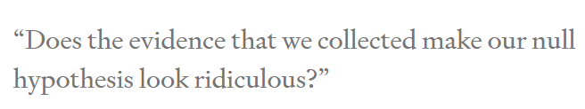
Alternative action
Notes:
If u choose NO as the default action or null hypothesis
Then u won’t choose yes except if data makes pressing no feels ridiculous
<number>

Slide 9
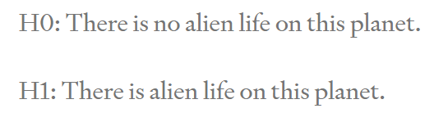

Slide 10


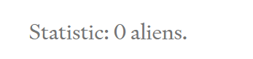
Collect data
Notes:
Thus no aliens on planet
Is it fair ?
U could have missed an alien that u didn’t see
<number>

Slide 11


Statistics
Notes:
Legal contract
We are only interested in population
Anything related to our sample is boring
<number>

Slide 12
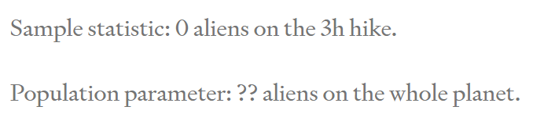
What did we learn?

Slide 13
What did we learn?
Notes:
Analytics can very easily find interesting results as we simply examine the sample only
<number>

Slide 14
Notes:
Medical oncology doctors
Search for a significant p value
<number>

Slide 15
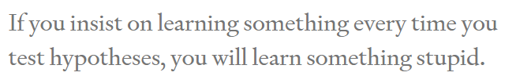

Slide 16
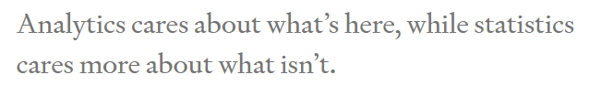

Notes:
Prof tom
The estimate is not the important thing
How confident are u with the estimate
<number>

Slide 17
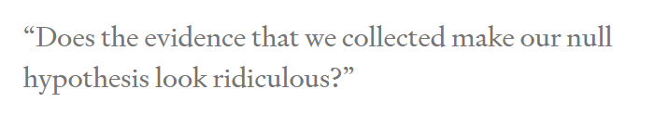
When to change mind?
Notes:
Making decisions based on facts (parameters) is hard enough as it is, but -curses!- sometimes we don’t even have the facts we need. Instead, what we know (our sample) is different from what we wish we knew (our population). That’s what it means to have uncertainty.
<number>

Slide 18

Notes:
Supposing it’s an alien not anything else
Found an alien
<number>

Slide 19
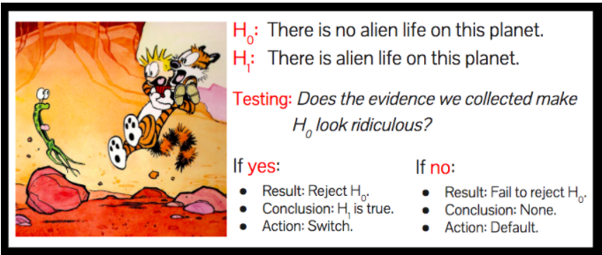
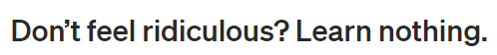
Notes:
<number>

Slide 20
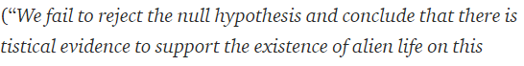


Slide 21


Actions vs learning
Notes:
Tragedy for learning nothing
We were not here to learn. We were here to take actions.
We have taken a sensible action based on data. We choose the wisely selected default action
<number>

Slide 22



Notes:
Why do the stats from the beginning ?
We could have laid down and choose the dafault button
Because u have actually worked hard, in a fairly manner, attempting to change ur mind if u get enough data.
Thus when u choose the default action now, u choose it wenta dameerak merta7
Ma3 enak 3aref en mmken yekoon kararak ghalat (uncertainty) bs this is the best u can do
And that’s why it is always good to increase sample size
To recude type 1 and type 2 errors
<number>

Slide 23
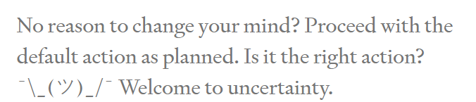
Am I right?
Notes:
<number>

Slide 24



How to measure “ridiculous”?
Confidence interval
P value
Notes:
Is the yelling enough to change ur mind?
The lower the p value
The more yelling at me
Leave the default action
How to measure yelling?
Compare to a preset significance level
This level determines how much risk u tolerate to take
If u set it to zero
U refuse to leave the default action
Don’t do statistics
The definition of a p-value is the probability of observing your statistic (or one more extreme in favor of the alternative) if the null hypothesis is true.
<number>

Slide 25


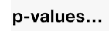
الملتقى
Classical tests( t test/ chi square / ANOVA/ .. )
Central limit theorem
Bootstrapping
Newer tests
Notes:
<number>

Slide 26
Difference between ci and p value?
Coming soon isA..

Slide 27
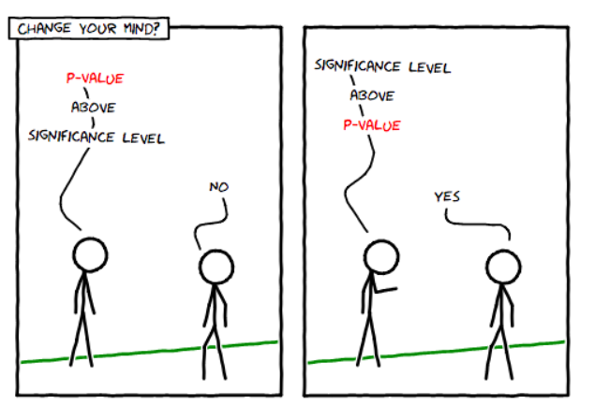

Slide 28
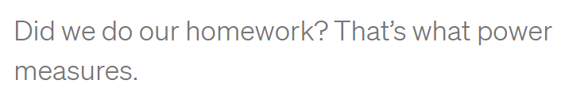

Notes:
3 hours were not enough
What about 30 sec
Easy to stick to default action, but results would be misleading
U didn’t do ur hw
The more u have the more opportunity u have given urself to change ur mind if that’s the right thing to do
<number>

Slide 29


1000000 hours
Notes:
Why not spend 1000000 hours
Balance between money and effort and time and benefit
<number>

Slide 30

Change default action
Pick YES?
Read the links for the answer ☺
Notes:
<number>

Slide 31
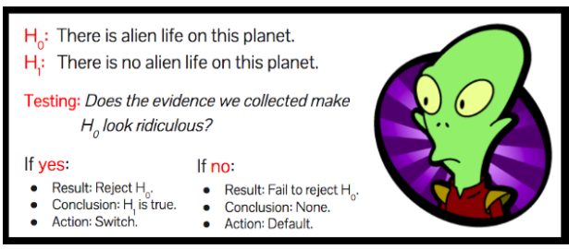

Slide 32
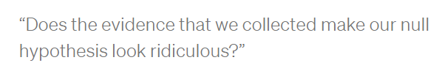
MAIN QUESTION
Notes:
<number>

Slide 33

Default action
!! What to expect??
Notes:
<number>

Slide 34
Answer is No. Always!
Notes:
Suppose we see an alien. Is our null hypothesis ridiculous? No, of course not. How about if we hike for three hours and we see no aliens? Is the null hypothesis of alien life ridiculous? Still no. (If you’re struggling with this, you should really go hiking on planet Earth some time. It’s easy to go three hours without seeing other humans…)
Evidence never make the null hypothesis ridiculous
<number>

Slide 35

2 OPTIONS
OR Every corner
sometimes we can see the answer. .No need to calculate
Notes:
Work from home
Or gather entire population! (that’s not statistics)
<number>

Slide 36
Bottom line!
Start with default action. Choose wisely!
Don’t have default action? No need for statistical inference!

Slide 37
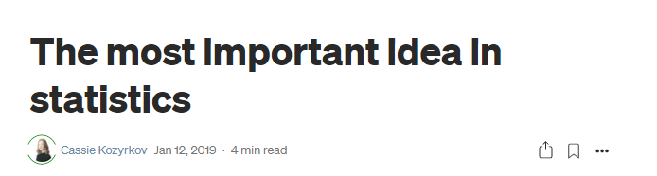
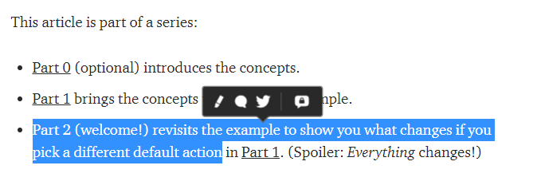
Notes:
The most important idea in statistics | by Cassie Kozyrkov | Towards Data Science
https://towardsdatascience.com/the-most-important-idea-in-statistics-8c18d514ad1c
Statistical inference in one sentence | by Cassie Kozyrkov | HackerNoon.com | Medium
https://medium.com/hackernoon/statistical-inference-in-one-sentence-33a4683a6424
<number>

Slide 38

P values

Slide 39

Setting the scene

Slide 40
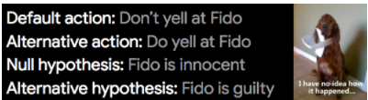

Slide 41
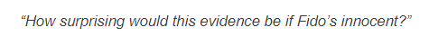
Describe the null world
Answer is pvalue
Notes:
What we’re doing here is visualizing the null hypothesis world and figuring out how things work there so we can make a toy model of it. That’s what the calculations are all about.
<number>

Slide 42

Little monster
Notes:
<number>

Slide 43

Living alone
Notes:
<number>

Slide 44
conclusion
“If I’m living in my default action world, how surprising is my evidence?”
p-value low enough ➔ change my mind

Slide 45

But which is small enough?
0.06
0.04
0.01
0.00001
Notes:
We need a reference!
<number>

Slide 46

Notes:
My friend from animal friends.co argues with me
5% yelling by error would be too much
<number>

Slide 47
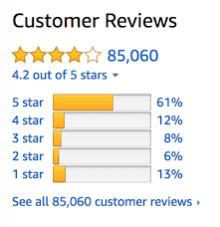
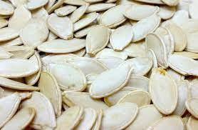
Take the decision for threshold in advance!!

Slide 48
0.05 threshold
5% of times. Wrongly change ur mind FALSE POSITIVE

Slide 49
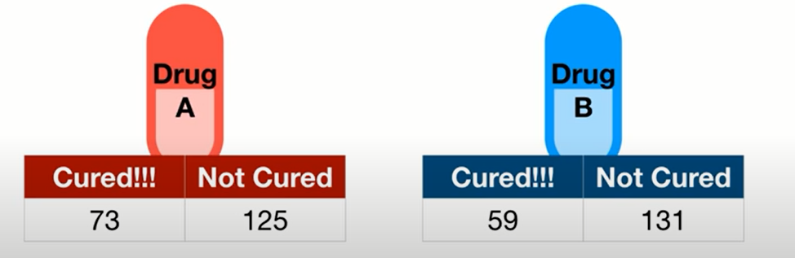
0.05 threshold
What’s the null hypothesis?
5% of times. U will decide they’re different. [while they are not different]
FALSE POSITIVE
Notes:
Null hypothesis: drugs equal
<number>

Slide 50
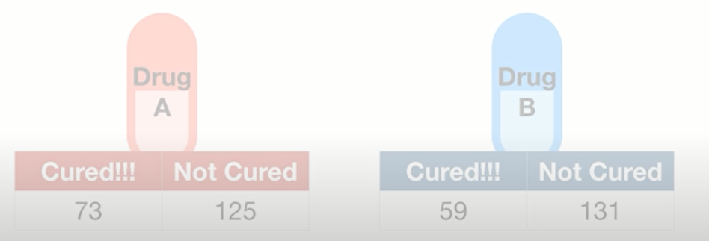
Critical drug!
0.01 threshold
1 False positive every 100 experiments
Notes:
If it’s extremely important to avoid false positive, use a lower threshold
<number>

Slide 51
Ice cream arrival on time
0.2 threshold
20 False positive every 100 experiments
20% of times. Wrongly change ur mind FALSE POSITIVE

Slide 52
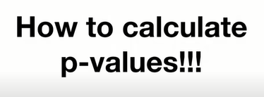

Slide 53
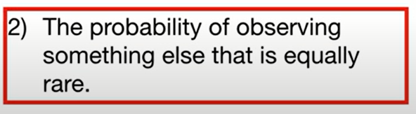
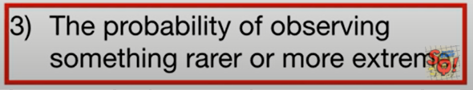
Two sided p value
As extreme, or more extreme
as the data
Notes:
<number>

Slide 54
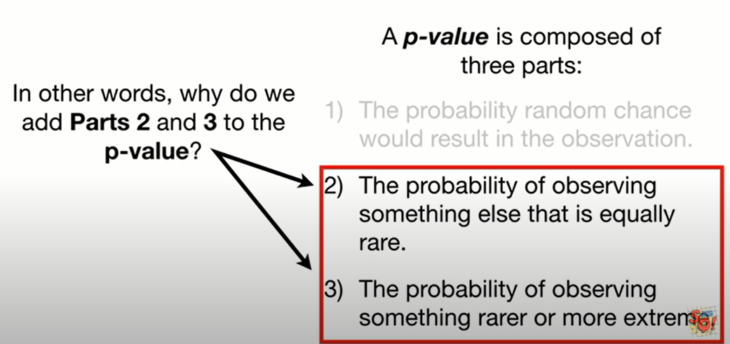

Slide 55

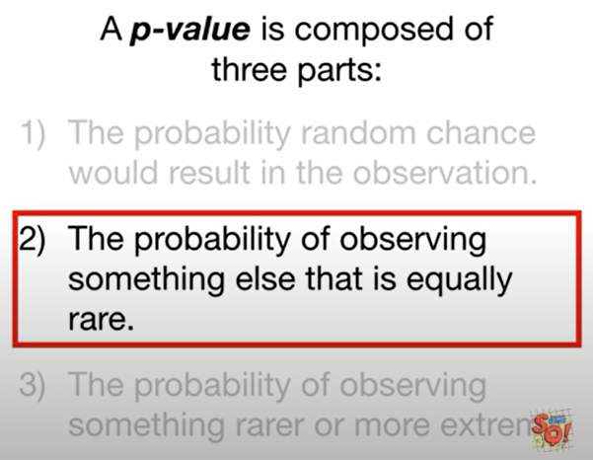

Why add part2?
Notes:
U told ur wife, that’s the rarest flower
She will be surprised
She may give u her jewelery (shabka)
<number>

Slide 56

Why add part2?
Equally as rare
Notes:
She won’t be that surprised. Even if the flowers are different. The event is not rate anymore
<number>

Slide 57

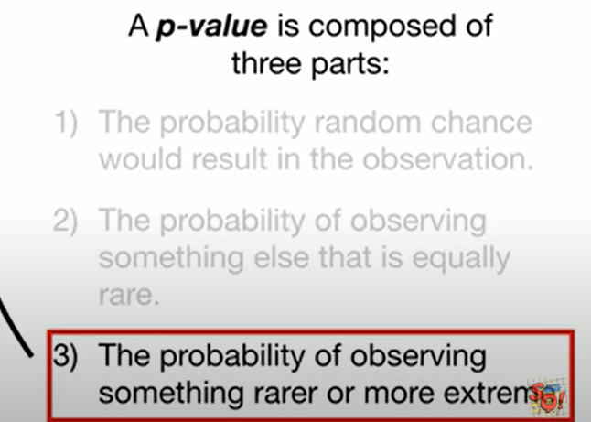
Why add part3?
More flowers are rarer than this flower
Notes:
Again, she won’t be surprised
<number>

Slide 58

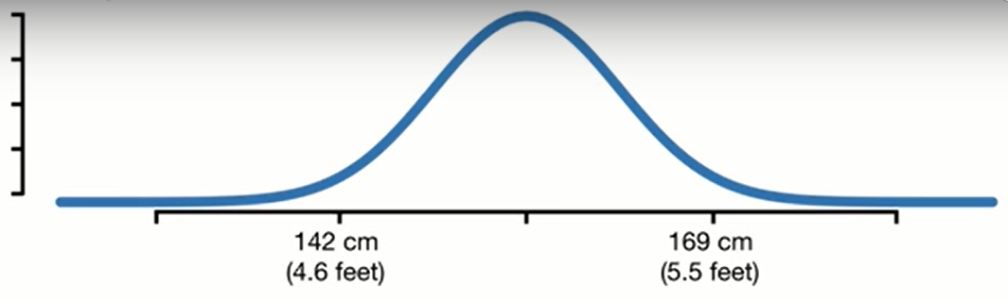
experiment

Slide 59
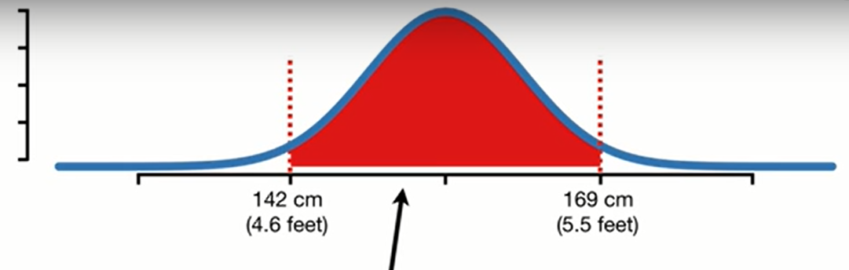
95% CI

Slide 60
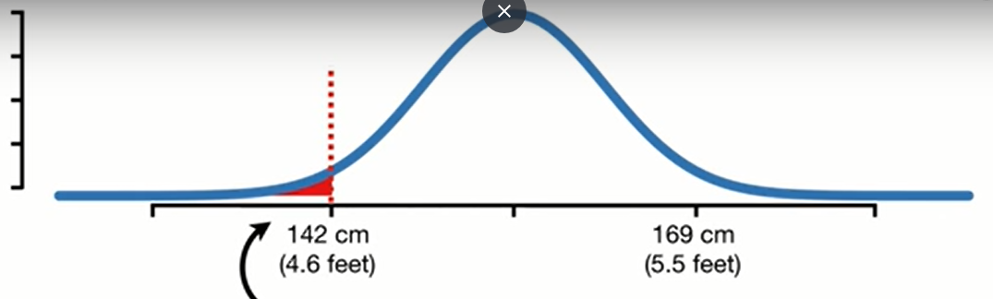
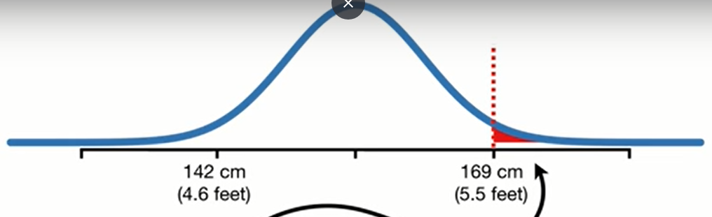
Notes:
2.5% at each side
<number>

Slide 61
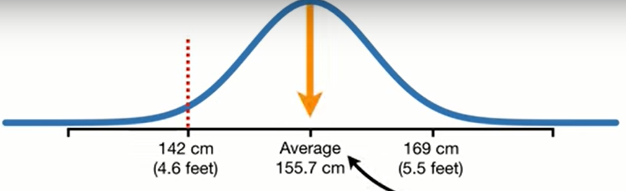
belong to NULL HYPOTHESIS WORLD?
Alpha = 0.05
Null : population average = 155
Notes:
We measure a person height to be 142cm
Does it belong to this distribution that has a mean of 155.7?
<number>

Slide 62
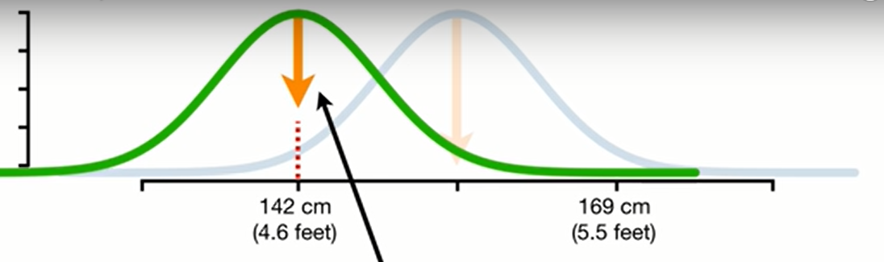
OR ALTERNATIVE HYPOTHESIS WORLD?
Alternative: population average != 155

Slide 63
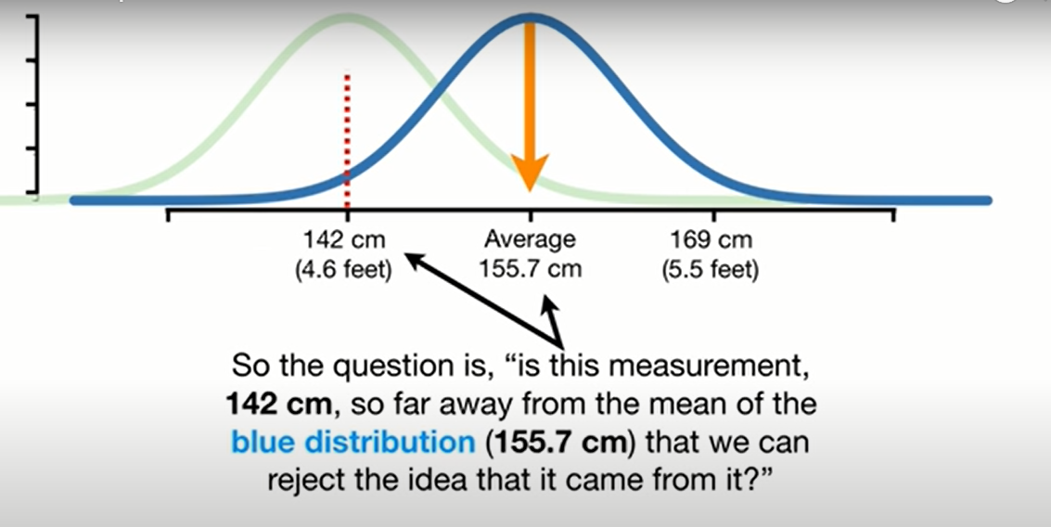

Slide 64
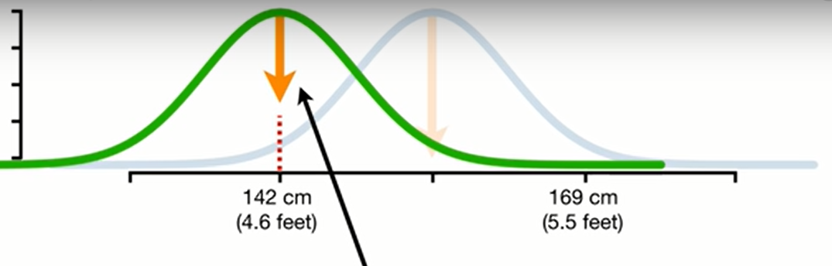
Doing a better job
Notes:
<number>

Slide 65
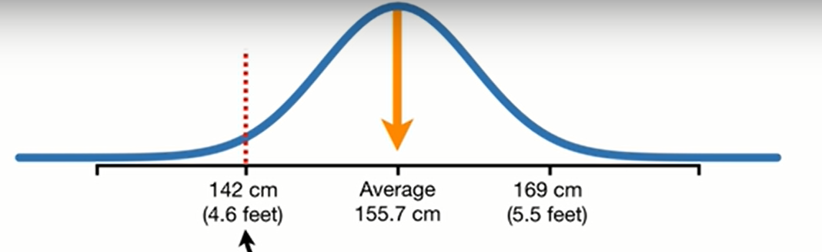
Calculate p value under the null
Which areas should we shade?
Notes:
<number>

Slide 66
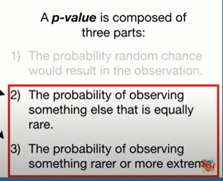
remember

Slide 67
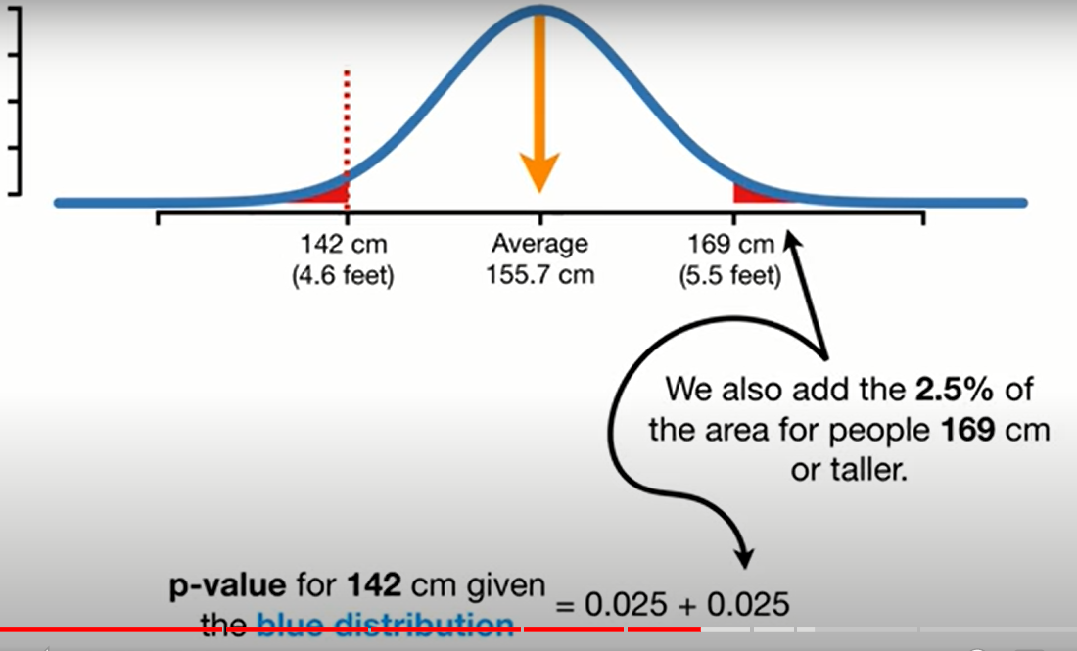
Then compare to a preset threshold

Slide 68
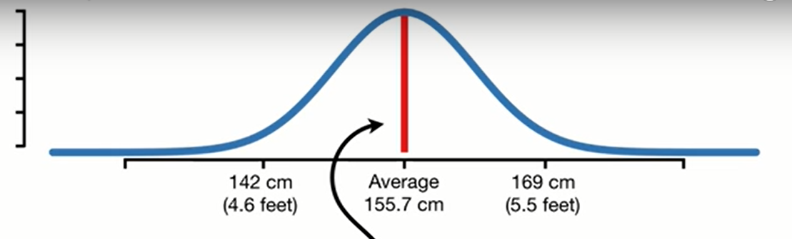
What if we measured someone here?

Slide 70
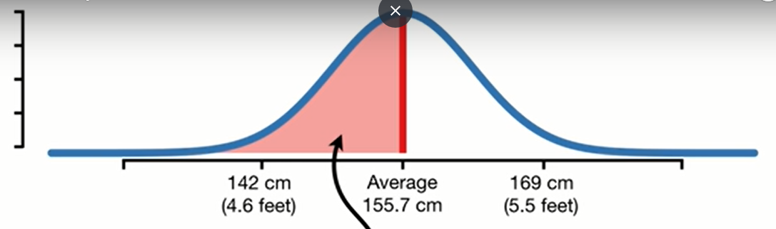
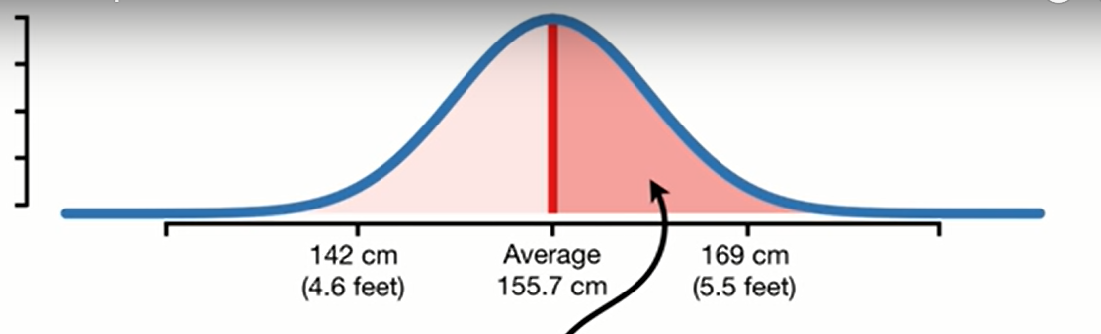
More extreme

Slide 71
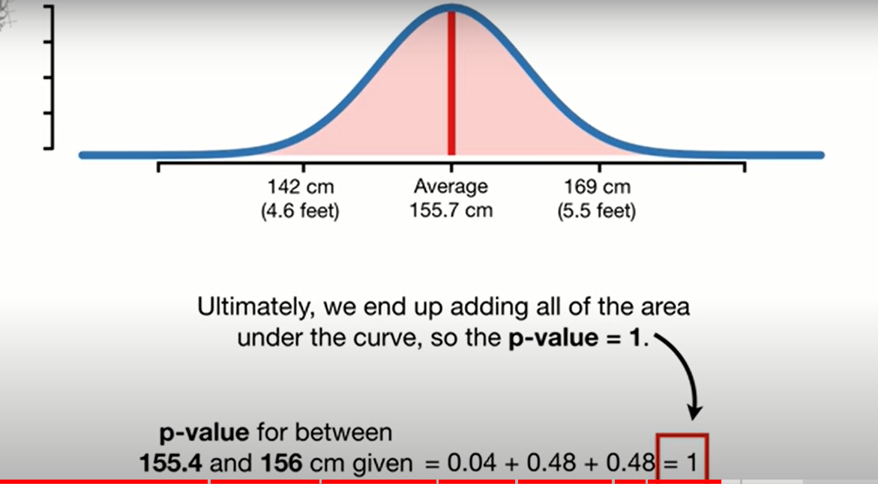

Slide 72
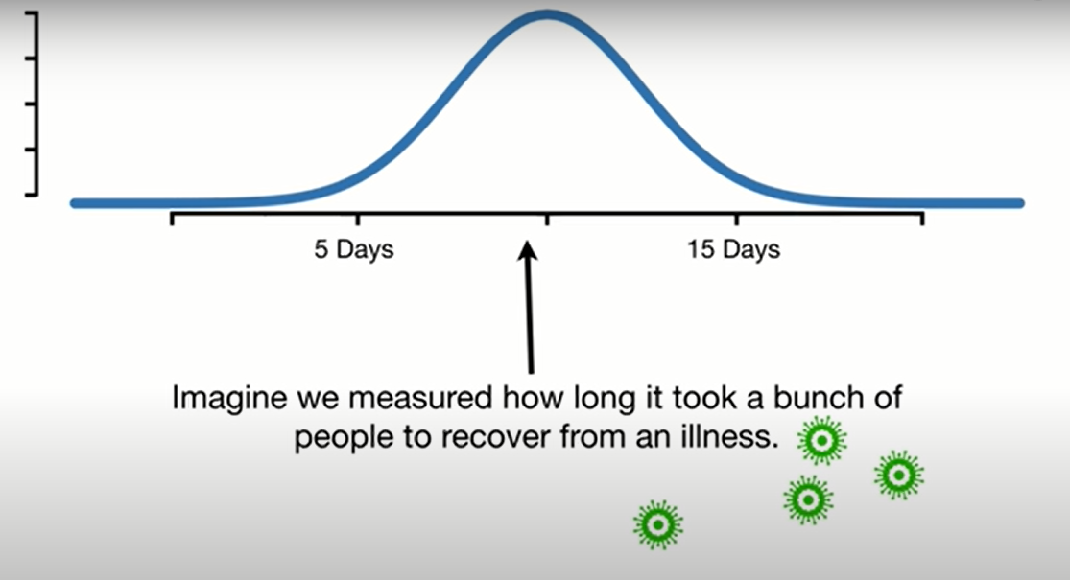
One sided p value

Slide 73
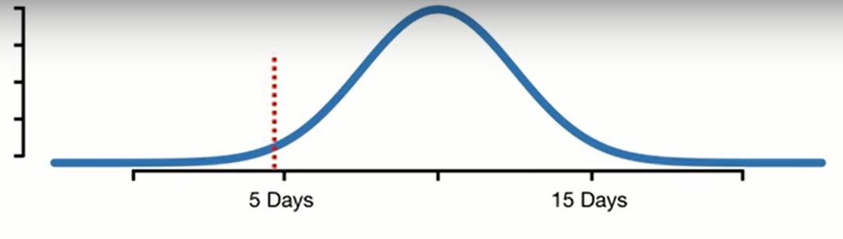
Super drug
Null: days >= 10 Alt days <10
Where are more extreme values?
Notes:
We want to test if superdrug help people recover in a short time
We gave the drug to a bunch of people and the results are the red line
<number>

Slide 74
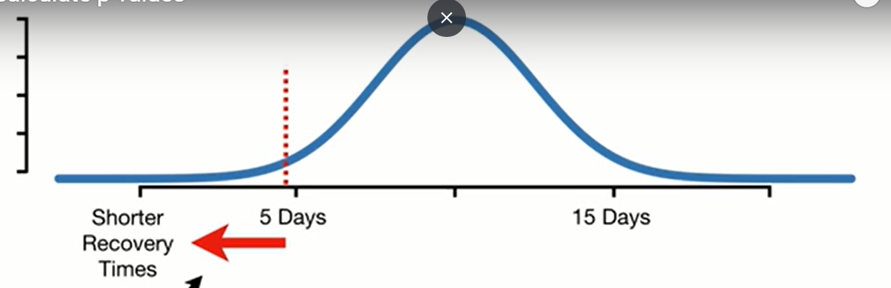
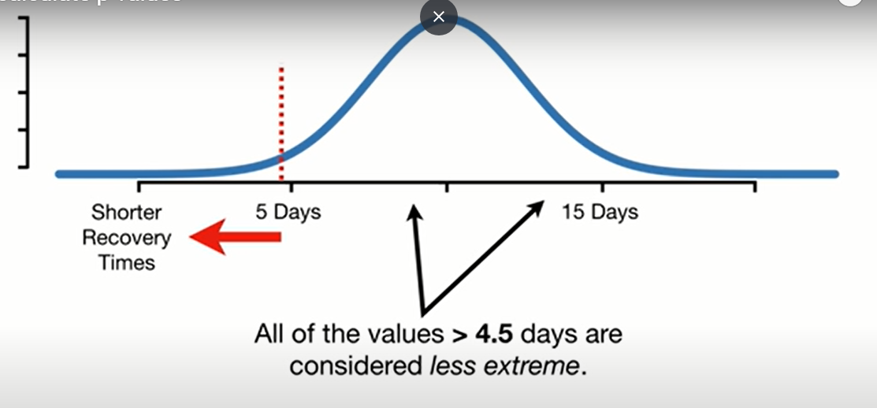

Choose direction
Notes:
<number>

Slide 75


Slide 76


Slide 77

More info?
Notes:
How to calculate p-values - YouTube
https://www.youtube.com/watch?v=JQc3yx0-Q9E
<number>

Slide 78



One sided
What if I want two sided?
Notes:
Imp conclusion
Simulate the values of your statistic that are possible from the null.
Calculate the value of the statistic you actually obtained in your data.
Compare your statistic to the values from the null.
Calculate the proportion of null values that are considered extreme based on your alternative.
<number>

Slide 79


Notes:
<number>

Slide 80


P values Pitfalls?

Slide 81


P hacking
Notes:
p-hacking, or cheating on a p-value | Freakonometrics
https://freakonometrics.hypotheses.org/19817
<number>

Slide 82

Confidence interval

Slide 83
الملتقى
Classical tests( t test/ chi square / ANOVA/ .. )
Central limit theorem
Bootstrapping
Newer tests
Notes:
<number>

Slide 84
Confidence intervals
Many ways to calculate them
We will use the one with bootstrap
https://rpsychologist.com/d3/ci/

Slide 85



Notes:
Some samples included more than once
Others weren’t included
<number>

Slide 86


Repeat previous steps
What about 99%
confidence interval?
Notes:
Same but covers 99% of the means
<number>

Slide 87


Slide 88

Solution
Outside CI
i.e. significant

Slide 89

More info?
Notes:
StatQuest: Confidence Intervals - YouTube
https://www.youtube.com/watch?v=TqOeMYtOc1w
<number>

Slide 90


Any advantages?
Panadol vs Tramadol
Notes:
While the P-value interpretations only differ between results with P < 0.05 and P > 0.05, the confidence interval approach offers five different interpretations, (1) statistically significant and important difference, (2) statistically significant difference which may be important, (3) not statistically significant though A may be better by an important amount, (4) not statistically significant and if there is a difference it is not important, and (5) inconclusive, as an important difference (in both directions) is possible.
Considerations for the design, analysis and presentation of in vivo studies - ScienceDirect
https://www.sciencedirect.com/science/article/pii/S1063458416301911#fig1
<number>

Slide 91
Any advantages?
Direction
Effect Size
significance
Error
Notes:
While the P-value interpretations only differ between results with P < 0.05 and P > 0.05, the confidence interval approach offers five different interpretations, (1) statistically significant and important difference, (2) statistically significant difference which may be important, (3) not statistically significant though A may be better by an important amount, (4) not statistically significant and if there is a difference it is not important, and (5) inconclusive, as an important difference (in both directions) is possible.
Considerations for the design, analysis and presentation of in vivo studies - ScienceDirect
https://www.sciencedirect.com/science/article/pii/S1063458416301911#fig1
<number>

Slide 92

Difference

Slide 93

ratio

Slide 94

reporting

Slide 95

Notes:
Confidence interval or p-value?: part 4 of a series on evaluation of scientific publications - PubMed
https://pubmed.ncbi.nlm.nih.gov/19547734/
<number>

Slide 96


Slide 97

🖌

Slide 98


Slide 99


Slide 100


Slide 101


Slide 102

Notes:
Center is at 1 for ratios
For ratios, 1 means similar
Ratios are the relative space while difference is the absolute space and is centered at 0

Slide 103


Slide 104


Slide 105


Slide 106


Slide 107

Notes:
U could say instead : inconclusive difference
Or the estimate for the difference was … with … CI
The later reporting gives the reader the chance to analyze the results on his own and judge whether these differences are important or not.

Slide 108


Slide 109
Statistical workflow
how to handle statistical problems?
Good, bad, ugly, better??
Notes:
There is no single method.
No method would say no. It just spits out answers. Thus, decisions are taken
What’s the worst and what’s the best?
<number>

Slide 110

Trial

Slide 111

Notes:
5 felt better
3 worse
Mean = 0.5
Is the drug effective ?
<number>

Slide 112

Random things we can’t control?
How to draw valid conclusions?
Notes:
Why 0.5 not 0?
Maybe the 5 respondents had adopted a good lifestyle and the other 3 had a worse lifestyle
<number>

Slide 113

population

Slide 114

Repeat experiment?
Notes:
<number>

Slide 115


Sampling Distribution
Any better option?
Notes:
Mean close to 0 most of the time
Mean away from 0 rarely
Concluision: Drug is not effective
However, Time money effort availability issues
<number>

Slide 116

bridge the gap … assumptions
assume Normal

Slide 117

pros
Notes:
which_test_flowchart.png (6131×2669)
https://onishlab.colostate.edu/wp-content/uploads/2019/07/which_test_flowchart.png
Many tests with relatively high power
<number>

Slide 118

cons
P value parametric: 0.04
P value non par. : 0.63
Notes:
Look at mean and median for both males and female
Look how females are right skewed
GraphPad Prism 9 Statistics Guide - The Mann-Whitney test doesn't really compare medians
https://www.graphpad.com/guides/prism/latest/statistics/stat_nonparametric_tests_dont_compa.htm
<number>

Slide 119
How to check normality?
Notes:
which_test_flowchart.png (6131×2669)
https://onishlab.colostate.edu/wp-content/uploads/2019/07/which_test_flowchart.png
<number>

Slide 120



Normality tests

Slide 121

Assume normal sample distribution
Notes:
Law of large numbers: the larger the sample size, the closest ur sample statistics to the population parameter
The Central Limit Theorem states that with a large enough sample size the sampling distribution of the mean will be normally distributed.
The Central Limit Theorem actually applies for these well known statistics:
Sample means (\bar{x}x¯)
Sample proportions (pp)
Difference in sample means (\bar{x}_1 - \bar{x}_2x¯1​−x¯2​)
Difference in sample proportions (p_1 - p_2p1​−p2​)
And it applies for additional statistics, but it doesn't apply for all statistics! . You will see more on this towards the end of this lesson.
<number>

Slide 122


Notes:
Sample variances are actually known to follow a different type of mathematical distribution known as a chi-squared distribution. Which is a more right-skewed distribution than a normal.
<number>

Slide 123

Do not rely on CLT
Notes:
In the next concepts, you will see that the with large sample sizes the sampling distribution of certain statistics will never become normally distributed. So how do we know which statistics will follow normal distributions, and which will not?
So, you might be wondering already why is the Central Limit Theorem such a big deal? In our new age of computers, it probably isn't as big of a deal, but more on this coming up soon!
Instead of relying on CLT, we can use bootstrapping
<number>

Slide 124


bootstrapping
Notes:
bootstrap - Explaining to laypeople why bootstrapping works - Cross Validated
https://stats.stackexchange.com/questions/26088/explaining-to-laypeople-why-bootstrapping-works
The question asks, "if we are resampling from our sample, how is it that we are learning something about the population rather than only about the sample?" Resampling is not done to provide an estimate of the population distribution--we take our sample itself as a model of the population. Rather, resampling is done to provide an estimate of the sampling distribution of the sample statistic in question.
Using random.choice in python actually samples with replacement
<number>

Slide 125

How to bootstrap?

Slide 126


Sampling with replacement
Same number of measurments

Slide 127

Bootsrapped dataset

Slide 128

Different mean

Slide 129


Slide 130

bootstrapping

Slide 131



Slide 132

End result

Slide 133

Importance

Slide 134

Confidence interval
Does the interval include zero?
Notes:
Thus not significant
<number>

Slide 135


Fake data

Slide 136


Specific population
Old patients with diabetes

Slide 137

No difference
Are u sure?
Notes:
<number>

Slide 138
bootstrapping
Get the variation
Notes:
bootstrap - Explaining to laypeople why bootstrapping works - Cross Validated
https://stats.stackexchange.com/questions/26088/explaining-to-laypeople-why-bootstrapping-works
The question asks, "if we are resampling from our sample, how is it that we are learning something about the population rather than only about the sample?" Resampling is not done to provide an estimate of the population distribution--we take our sample itself as a model of the population. Rather, resampling is done to provide an estimate of the sampling distribution of the sample statistic in question.
Using random.choice in python actually samples with replacement
<number>

Slide 139


Bootstrapping instead of t-test
T-test – Python for Data Science
https://pythonfordatascienceorg.wordpress.com/independent-t-test-python/
Notes:
Tests for testing assumptions
Plots
Contradicting tests
<number>

Slide 140
No longer needed!

Slide 141
decisions
How to make decisions with t test?
How to make decisions with bootstrap?
How to make decisions when I use central limit theorem?

Slide 142
الملتقى
Classical tests( t test/ chi square / ANOVA/ .. )
Central limit theorem
Bootstrapping
Newer tests
Notes:
<number>

Slide 143
Confidence interval
What about 99%
confidence interval?
Notes:
Same but covers 99% of the means
<number>

Slide 144
Solution
Outside CI
i.e. significant

Slide 145


P value with bootstrapping
http://www.stat.ucla.edu/~rgould/110as02/bshypothesis.pdf

Slide 146
Different types of bootstrapping
parametric
Semi parametric
Non parametric
Pros and cons
Notes:
<number>

Slide 147




Bottom line
bootstrap
std
Notes:
<number>

Slide 148


Easier way?
Notes:
bootstrapped · PyPI
https://pypi.org/project/bootstrapped/
<number>

Slide 149


Slide 150
Advanced
Notes:
Sampling Distribution of the Sample Proportion, p-hat » Biostatistics » College of Public Health and Health Professions » University of Florida
https://bolt.mph.ufl.edu/6050-6052/module-9/sampling-distribution-of-p-hat/
<number>

Slide 151

advanced
Notes:
Jan Vanhove :: Some illustrations of bootstrapping
https://janhove.github.io/teaching/2016/12/20/bootstrapping
<number>

Slide 152

advanced
Notes:
Parametric or non-parametric bootstrap
https://influentialpoints.com/Training/nonparametric-or-parametric_bootstrap.htm
<number>

